Slide 1

SALES & INVENTORY MANAGEMENT SYSTEM (SIMS)
OF
KRISH VILLA ORGANIC (PRIVATE) LIMITED
BY
TEAM WARRIORS
Team Leader - Harsha Madushanka
Team Members - Nadaraja Wickneshwaran
Pasindu Jayasinghe
Wiraj Dharshana
Anjali Pawithra
Krishanthi Rathnayake

Slide 2

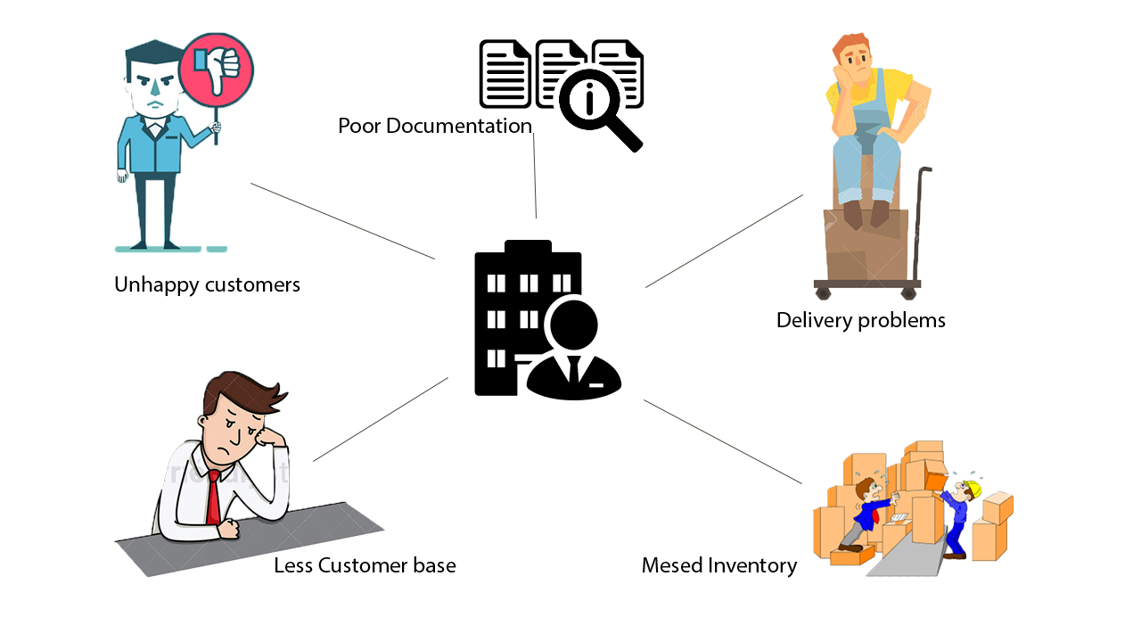
Company overview :
“KRISH VILLA ORGANIC” is registered as a partnership under the companies Act and further is involved in selling organic vegetables and fruits. The company has their own farms in Colombo and Lindula. Krish villa also has registered suppliers who themselves are organic farmers mainly in Horana, Bandaragama, Nuwara Eliya, Bandarawela, Lindula and also few areas in the Monaragala district. The owner Mr. Krishantha Jayawardena was in need of a web based application to cater for the growing demand of organic vegetables and fruits.
Problem Identified :

Slide 3






Manage Your Sales Order
Manage Your Customer, Farmer and Rider
SIMS
Manage Your Deliveries
Manage Your Purchases
Manage Your Inventory
Manage Your Inventory Wastage

Slide 4






Future Enhancements
E-Commerce Portal
CRM Functions
Payment Gateway
Cash Management
Centralized inventory management
Customer Loyalty

Slide 5


